Slide 1
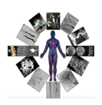
U.O.S.D. INTERVENTIONAL RADIOLOGY
“S. Eugenio” Hospital, Rome. ASL Roma2
Director : Dott. Roberto Cancellieri
Female69 yo
Hypertension
Diabetic
Amputation left leg
Symptoms rest pain, ulcer
Rutherford 5, Texas IC

Slide 2
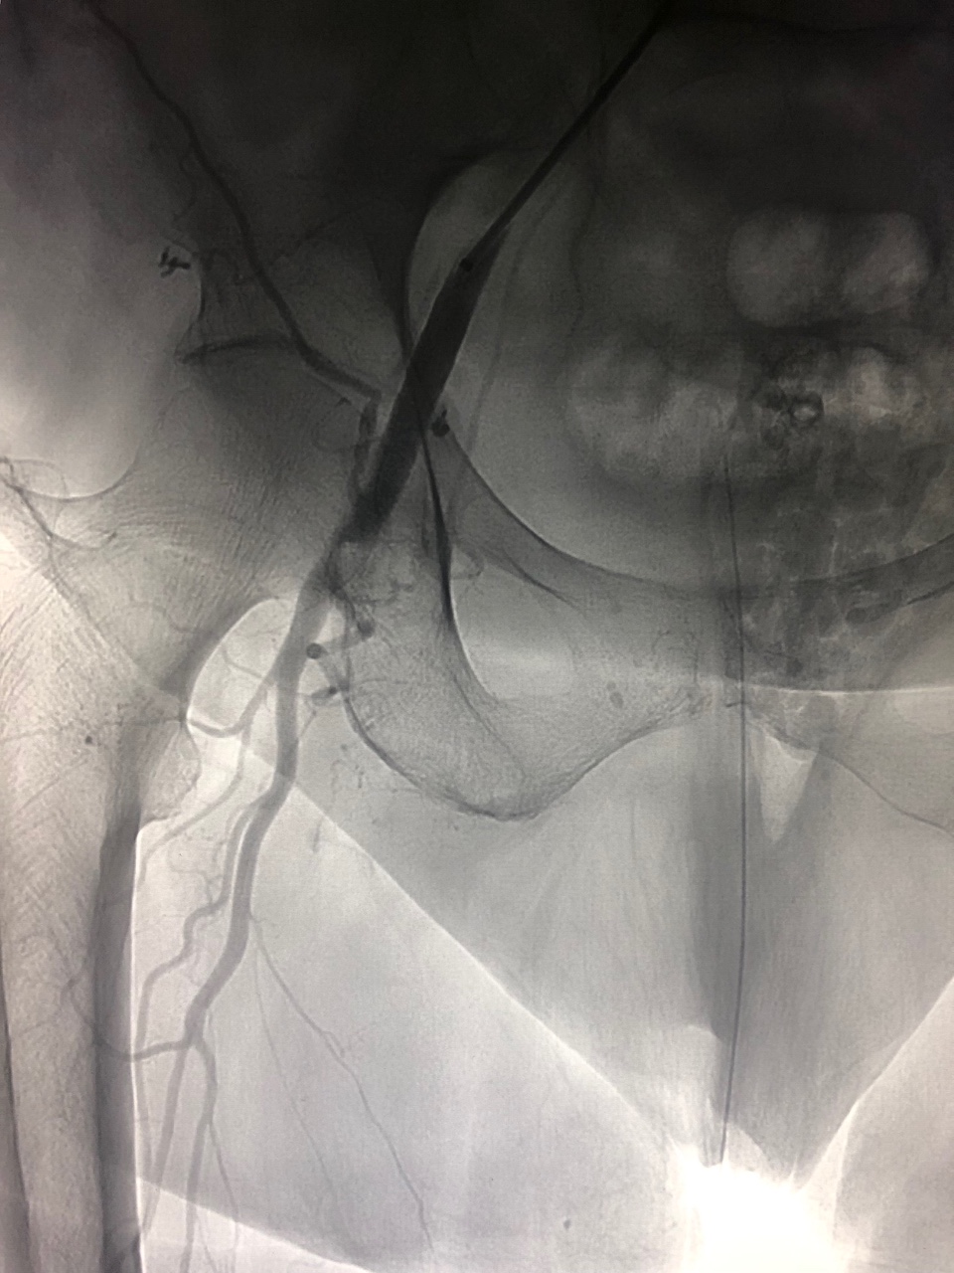
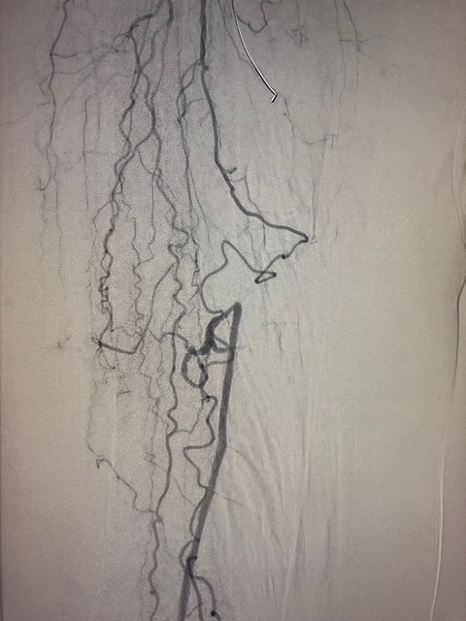

Slide 3
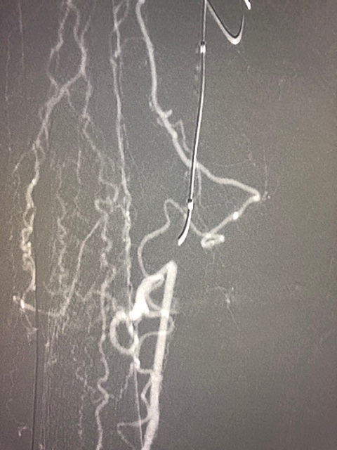
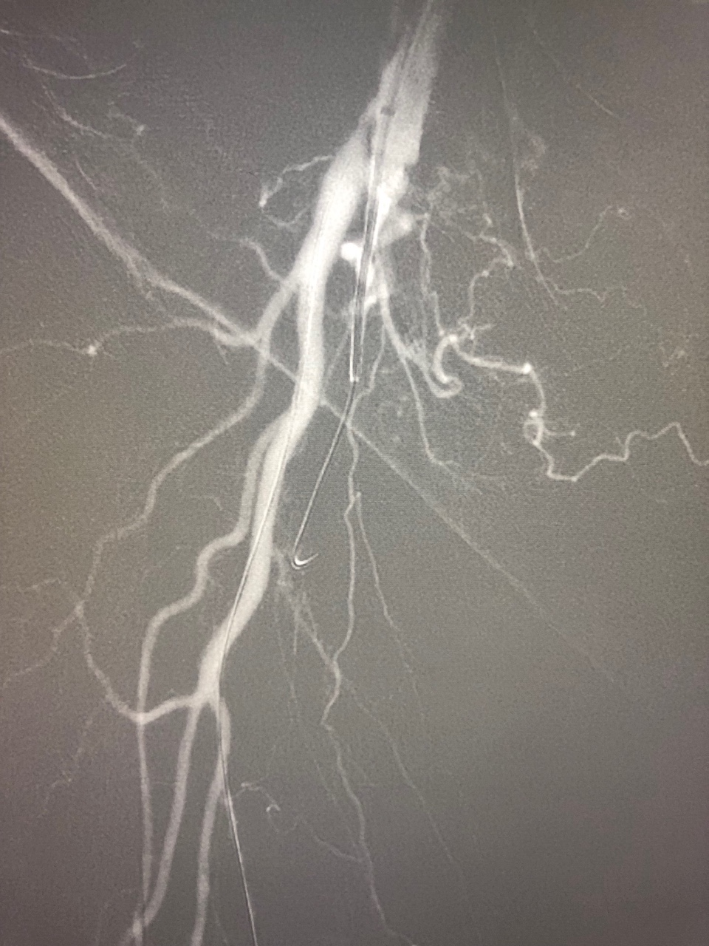
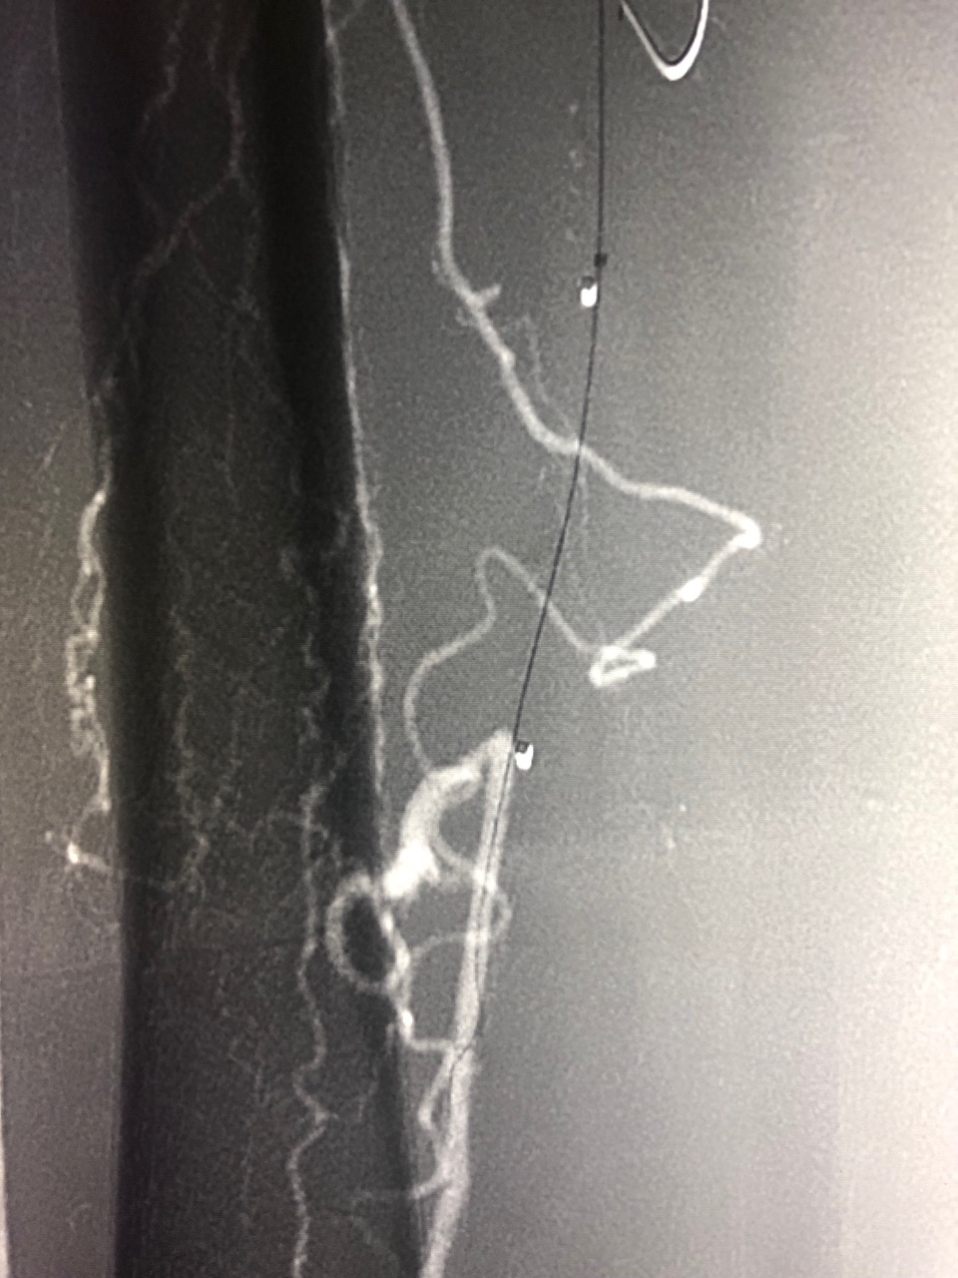

Slide 4
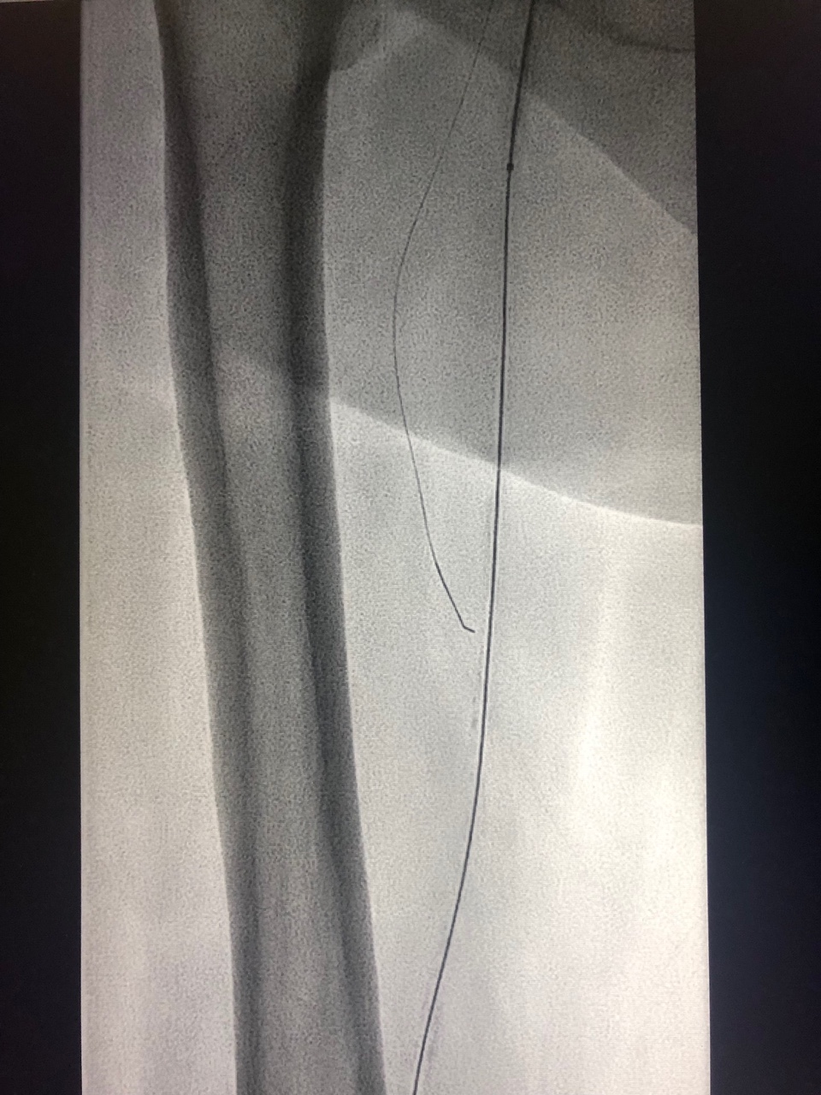
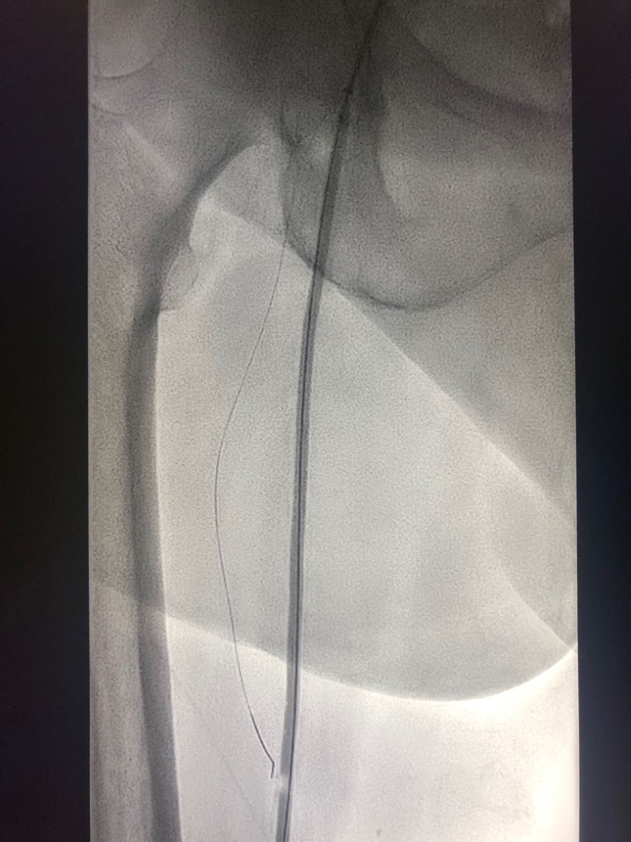
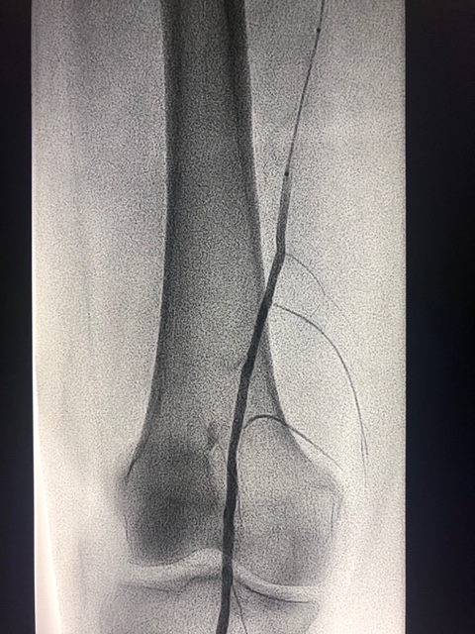
Mustang 4 x 200

Slide 5
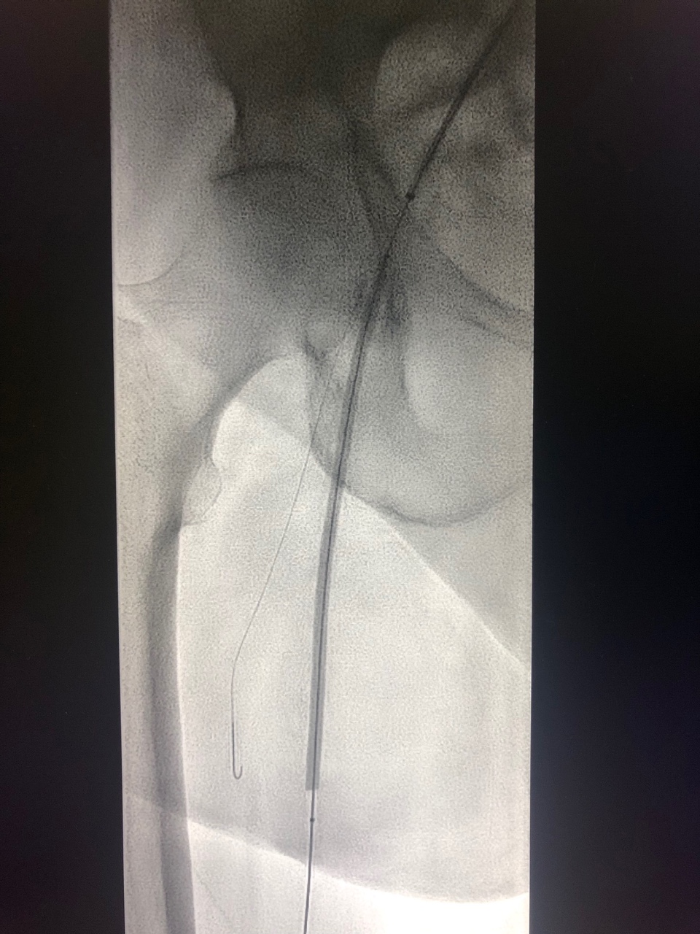
2 Lutonix 4 x 150

Slide 6
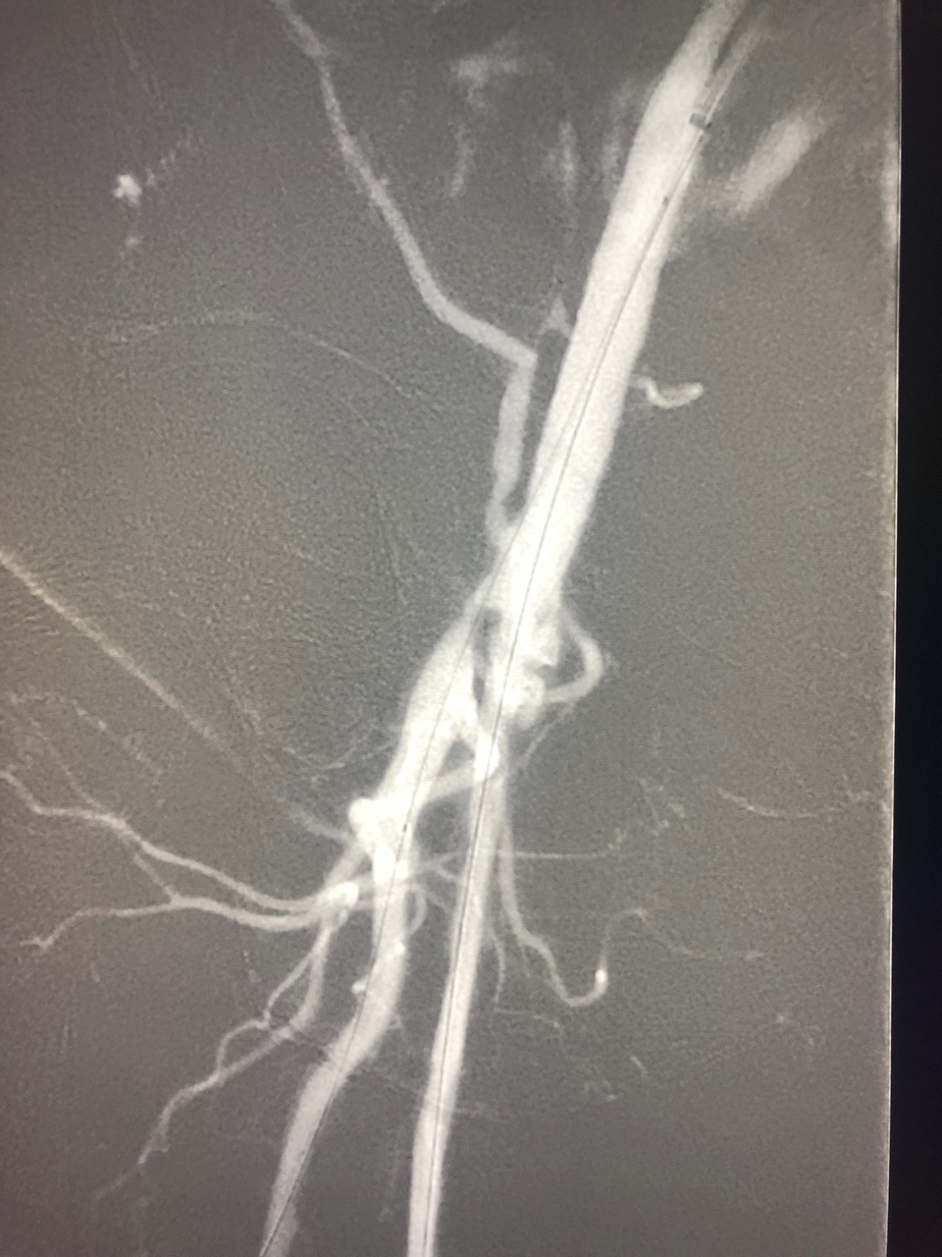
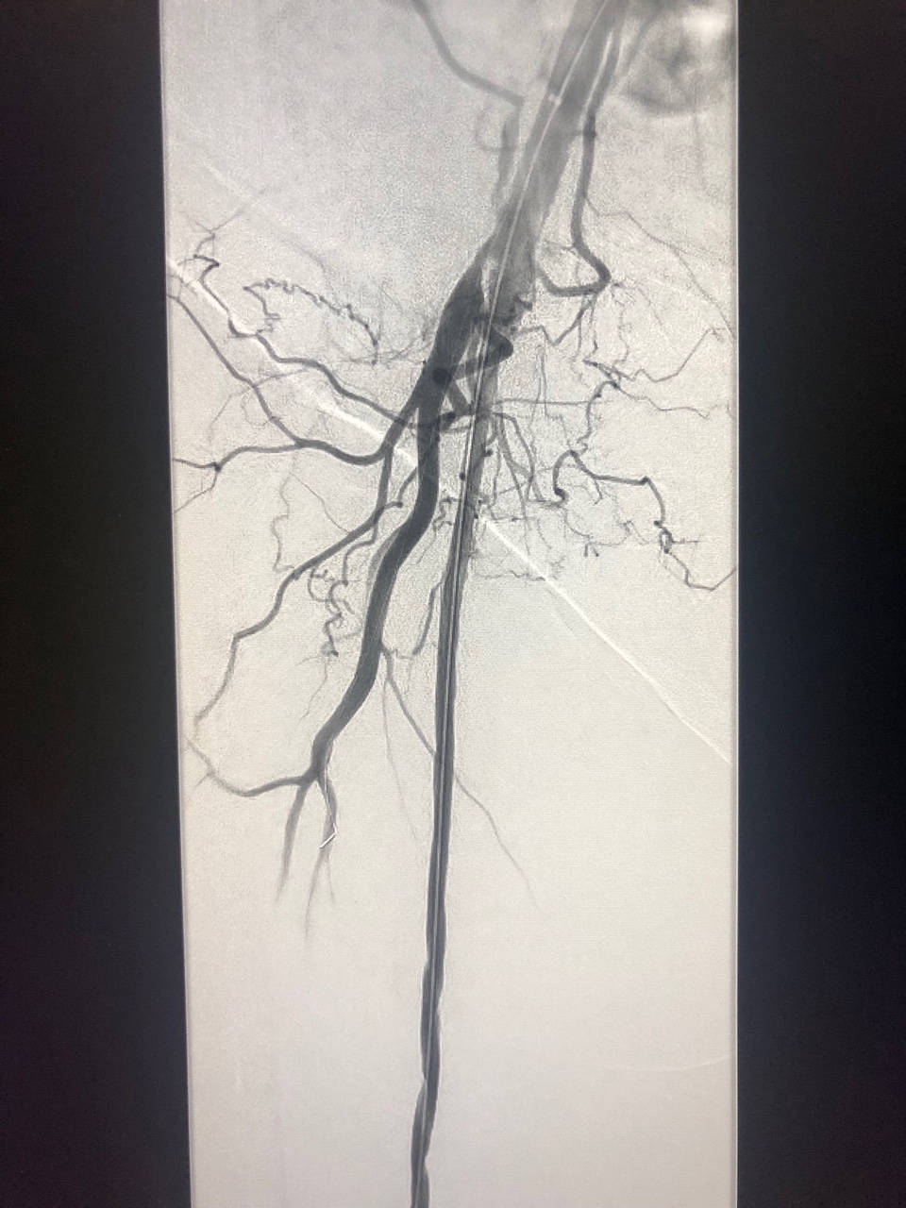
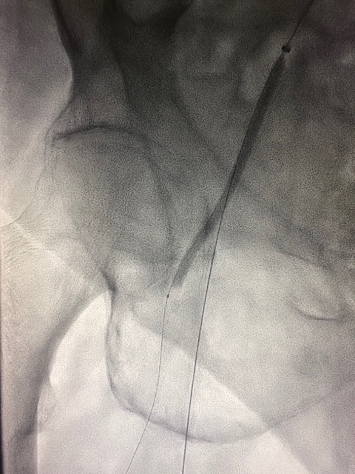
Chocolate 3.5 mm

Slide 7
