Slide 1
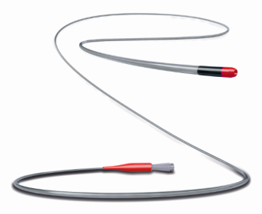
MAMBA Microcatheter Family
Torqueable microcatheters engineered to optimize support and durability without compromising flexibility and profile.
Crossing Profile
MAMBA Flex (2.1F)
MAMBA (2.4F)
Integrated Tip
Tapered Coil
HydroPass®: Durable & Lubricious Coating
MAMBA (135cm)
MAMBA Flex (135 & 150cm)
3 coil taper zones for:
Exceptional wire penetration support
Excellent pushability and torque
5 coil taper zones for:
Enhanced flexibility, deliverability, and wire follow in tortuous vessels
Notes:
Remove words

