Slide 1
A case of SFA intervention in a diffuse disease
Gianfranco Aprigliano MD
Interventional Cardiovascular Unit
Città Studi Clinical Institute
Milan, Italy

Slide 2
Clinical History
87 yrs, Male
Hypertension, Diabetes Type 2 (at 50’s)
Previous left leg amputation
CLI right leg, Ruth 5 (forefoot fhlegmon)> surgical treatment
Previous AMI, LVEF 35%
Duplex scan CTO SFA, TCPO2 15 mmhg
No surgical indication (no veins, high risk)

Slide 3
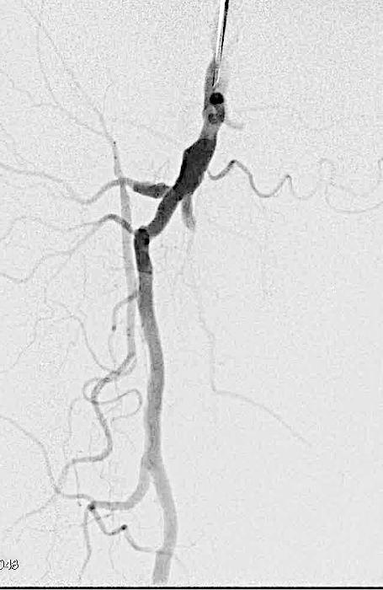
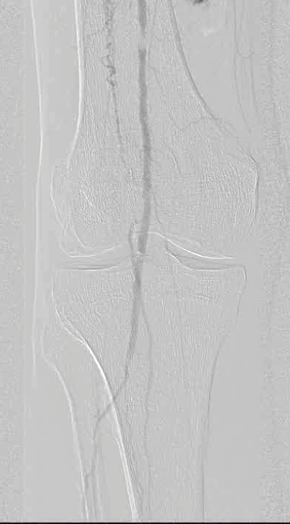
Right antegrade femoral angio
Distal superficial femoral short occlusion.
Occlusion of all 3 vessel with good collateral supply
Occlusion of pedal, arch and lateral plantar
Long SFA total occlusion

Slide 4
Antegrade subintimal femoral dissection

Slide 5
Antegrade femoral failure & rupture

Slide 6
Retrograde puncture & CART
CART= Controlled Antegrade and Retrograde subintimal Tracking

Slide 7
PTA, stenting and result
Balloon 5x150mm; Nitinol Stent 6x150 mm; balloon 6x60 mm

Slide 8
Final leg & foot angio

Slide 9
Clinical follow up
Progressive complete forefoot healing
Duplex scan revealed a 12 month focal intrastent restenosis (2016) treated with DEB (6x80 mm)
At 33 months follow up no new lesion, good patency at DS.

Slide 10
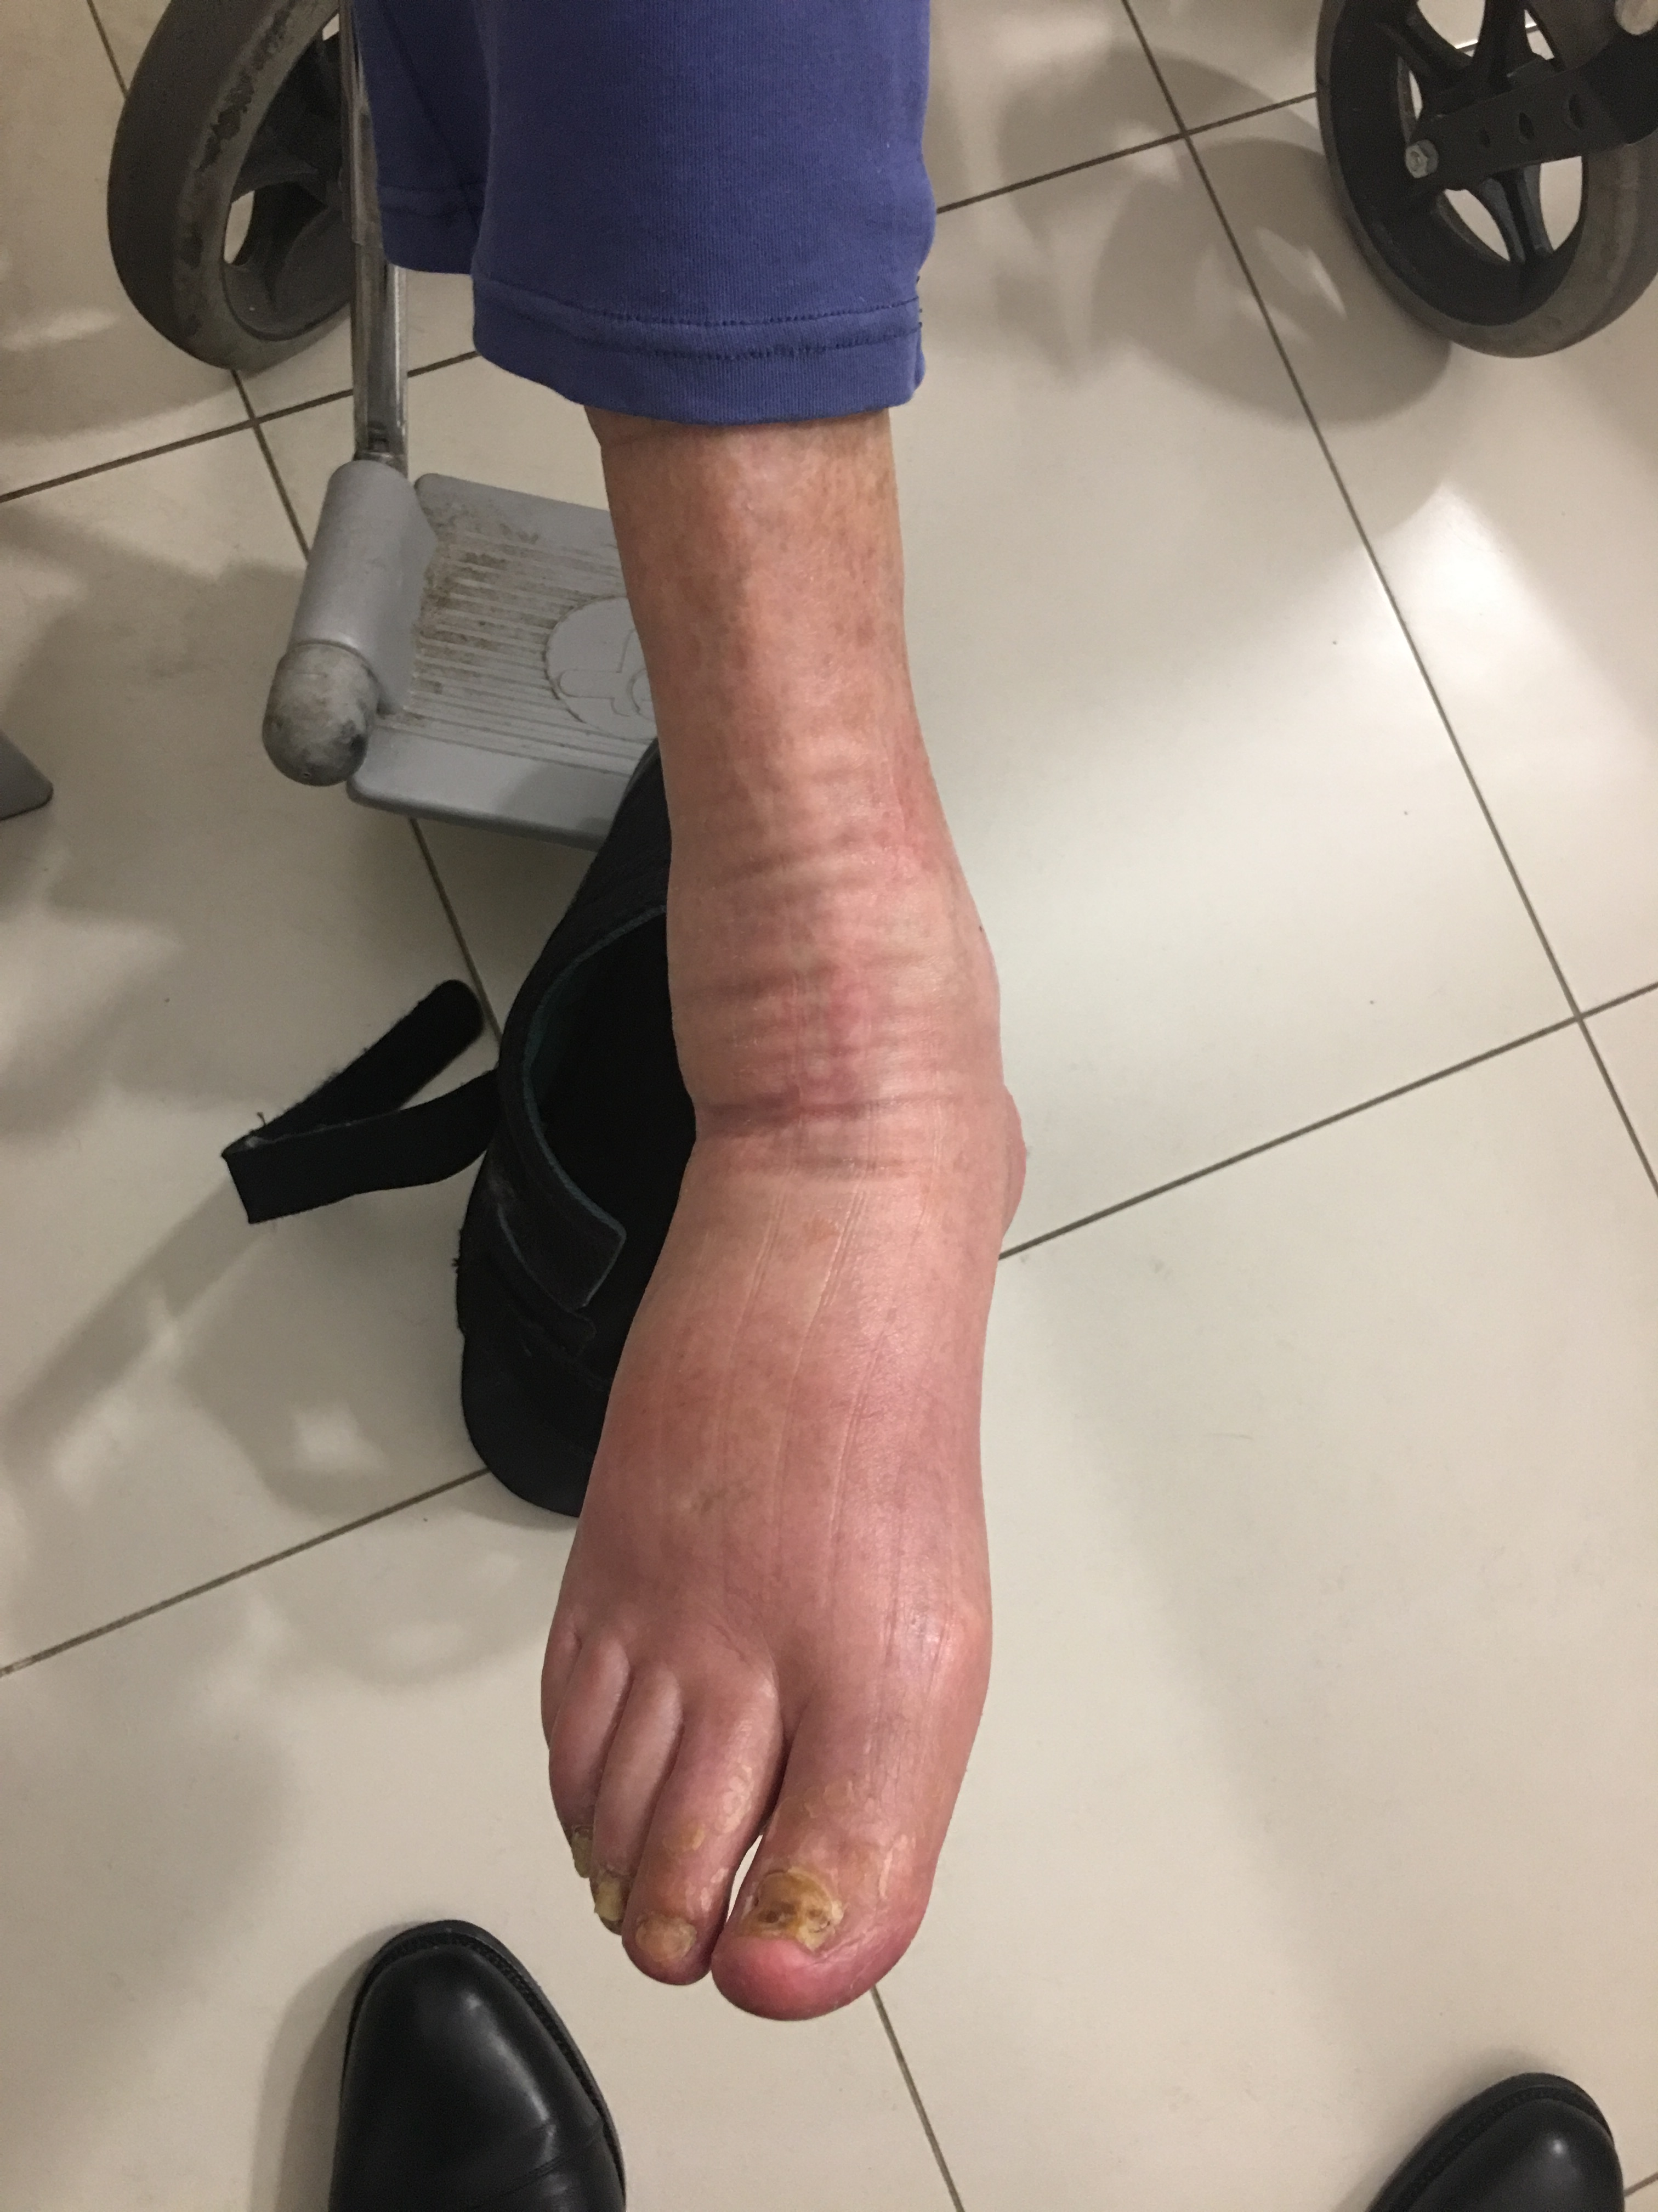
Sept 2018

