Slide 1
Intravascular lithotripsy
As vessel prep for calcified plaques in carotid artery stenting
Stefano Fazzini, MD, PhD
Vascular Surgery
Tor Vergata, University of Rome

Slide 2
Patient description
Patient History
63 YRS OLD, MALE (BLINDNESS SINCE 40 YRS, Congenital Retinitis Pigmentosa)
CAD, COPD, PAD (BILA RUTH 3), ACTIVE SMOKING
BILATERAL ASYMPT CAROTID STENOSIS (RT 80-90%, SN >90%)
RIGHT CAS ONE MONTH BEFORE (TYPE IV NIC, TERUMO ROADSAVER)
CALCIFIC >90% ICA STENOSIS, PLANNED FOR CEA >>> CAS
COMORBIDITIES, ABSOLUTE REFUSAL OF THE PATIENT
BECAUSE OF HIS BLINDNESS AND THE RISK OF PERIPHERAL NEUROLOGICAL COMPLICATION OF CEA

Slide 3
Description of the procedure
Type II calcified aortic arch, moderate vessels tortuosity
Left ICA, 90% stenosis
Eccentric 90% (PSV 600 cm/sec) and fully calcific plaque (Type V Nicolaides)
Vessel Prep by using INTRAVASCULAR LITHOTRIPSY
Ongoing Dual antiplatelet therapy
Local anesthesia

Slide 4
LEFT ICA: Preoperative DUS/CTA

Slide 5
Strategy and approach
Image and brief description
Lt femoral 6Fr access
90 cm Introducer Sheath (Penumbra Neuronmax)
Left CCA/ECA cannulation (Sim + Terumo Advantage 0.035)
Lesion + Cerebral 2D angiograms
Devices used
90 cm Introducer Sheath (Penumbra Neuronmax)
Terumo Advantage 0.035
Boston Filter Wire EZ
Sterling 3 x 20 mm (Predilatation)
Shockwave IVL M5⁺ 5.5 mm (6 Cycles, 180 pulses)
IVUS (Philips)
Stent implantation
Stenting area (ICA / CCA)
Size of target vessel location: Proximal diameter (mm): 6.6 mm Distal diam. (mm): 5.5 mm. Length: 40 mm
Specify stent size
Stent used: TERUMO ROADSAVER Diameter (mm):7 mm Length (mm): 25 mm
Post dilatation
Yes Balloon size: Sterling 5 x 20 mm

Slide 6
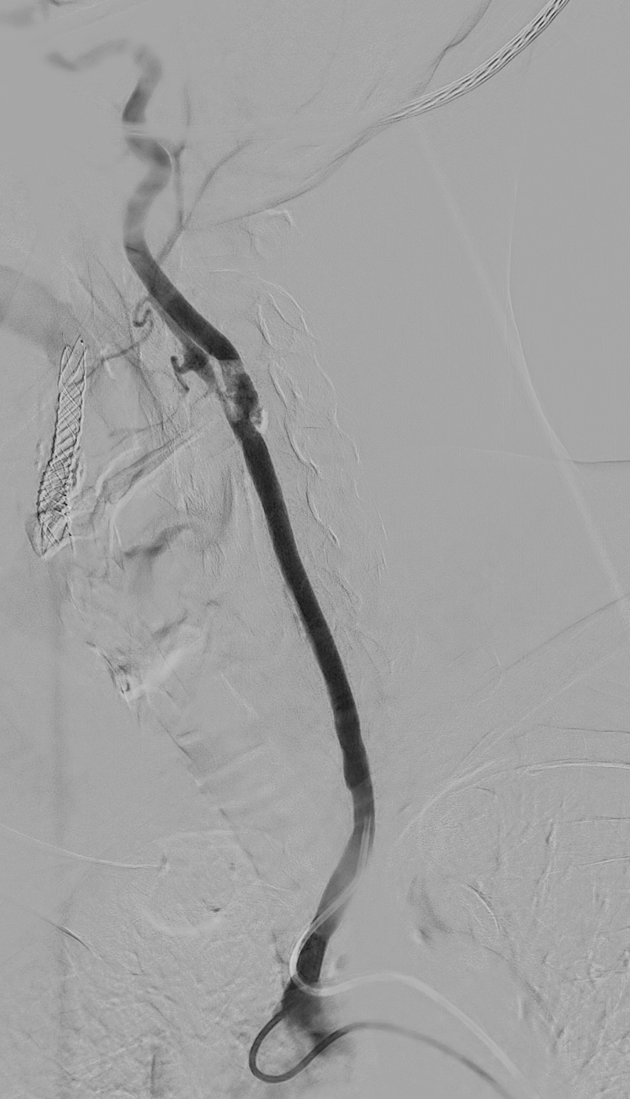
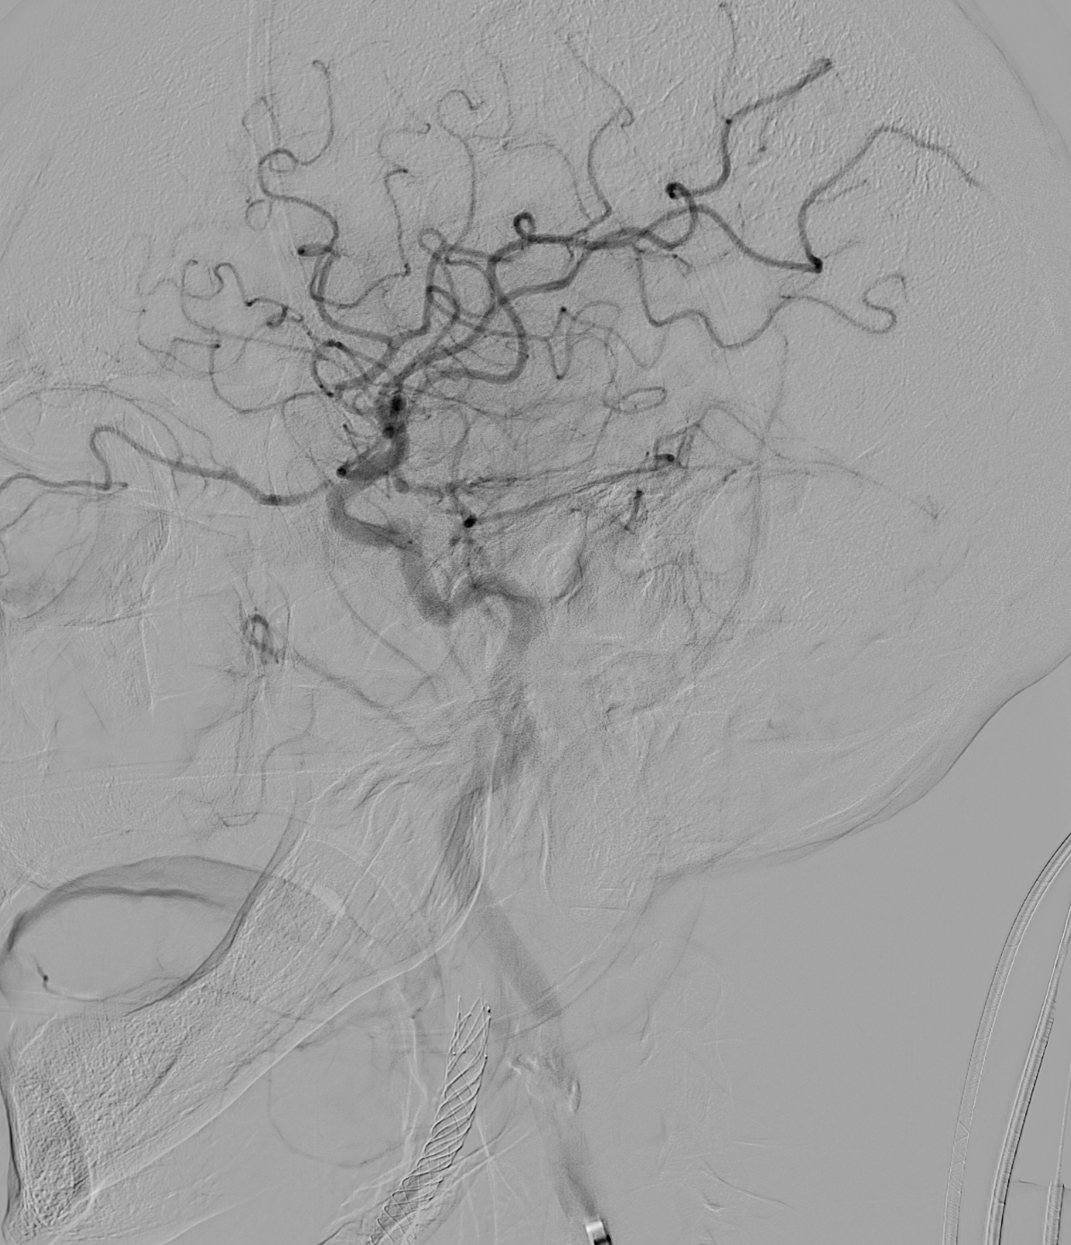
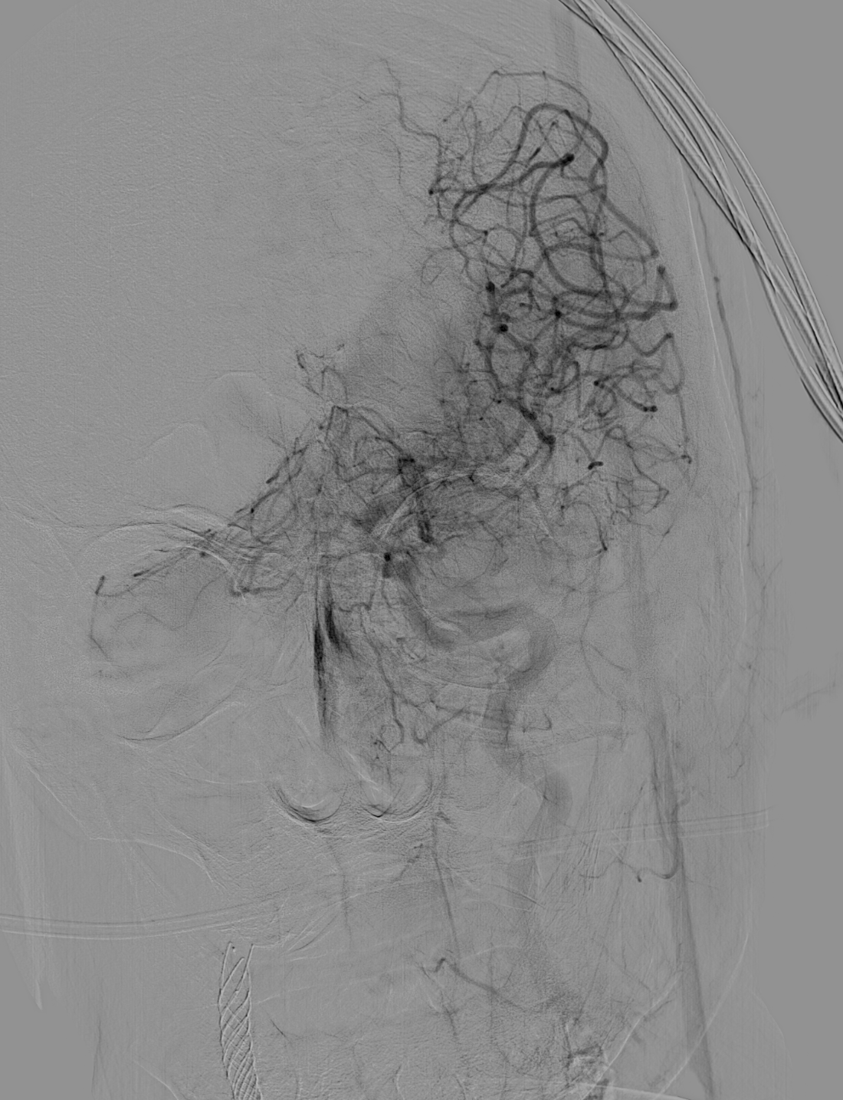
Cannulation and preoperative angiograms

Slide 7
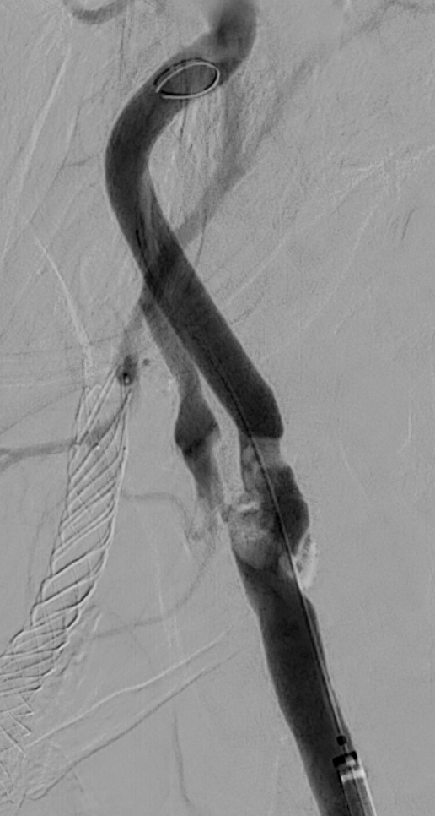
Preoperative angiogram
PRE IVL

Slide 8
Vessel Prep: IVL (6 cycles), multiple projections

Slide 9
Completion (post stenting) angiogram
POST
STENT

Slide 10
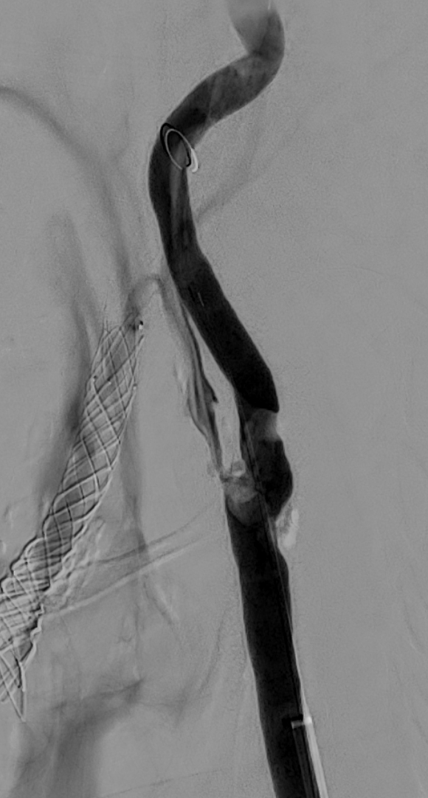
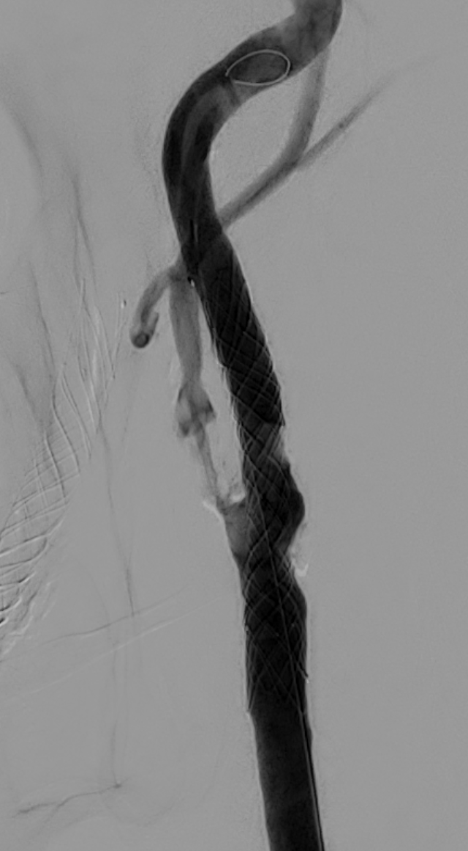
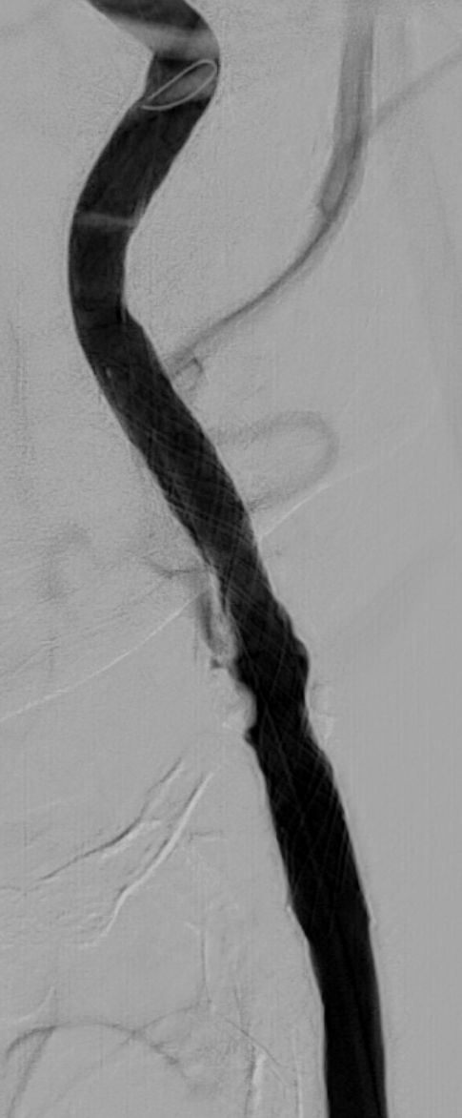
Vessel Prep (IVL) and carotid stenting
PRE IVL
POST
IVL
POST
STENT
Shockwave IVL M5+ 5.5 mm + Terumo Roadsaver 7 x 25 mm

Slide 11
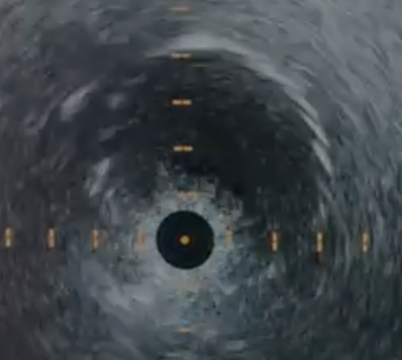
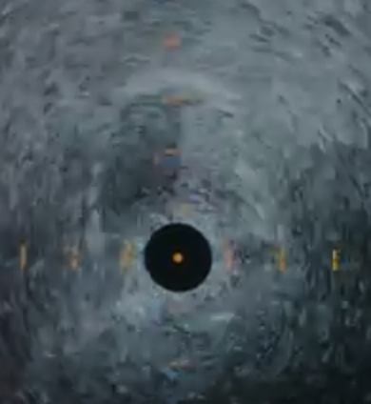
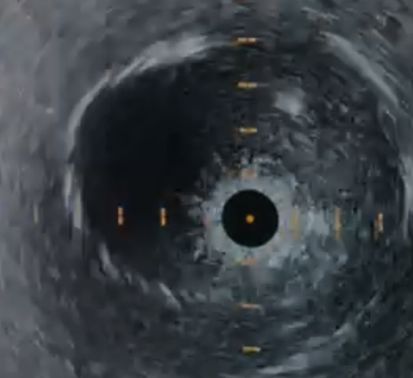
Final angiogram + IVUS

Slide 12
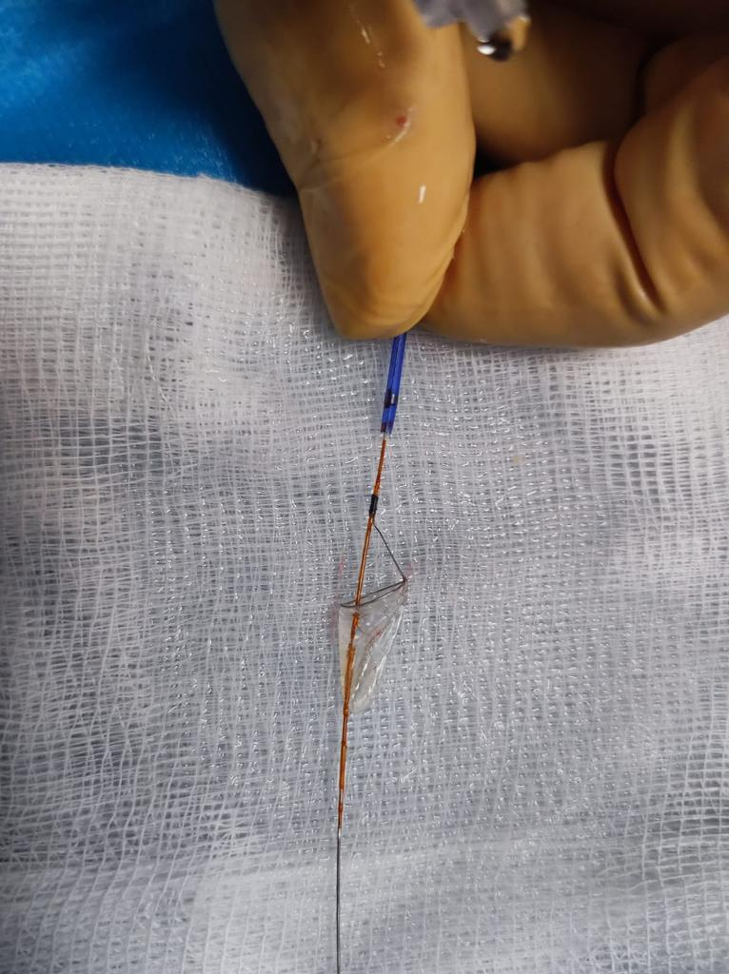
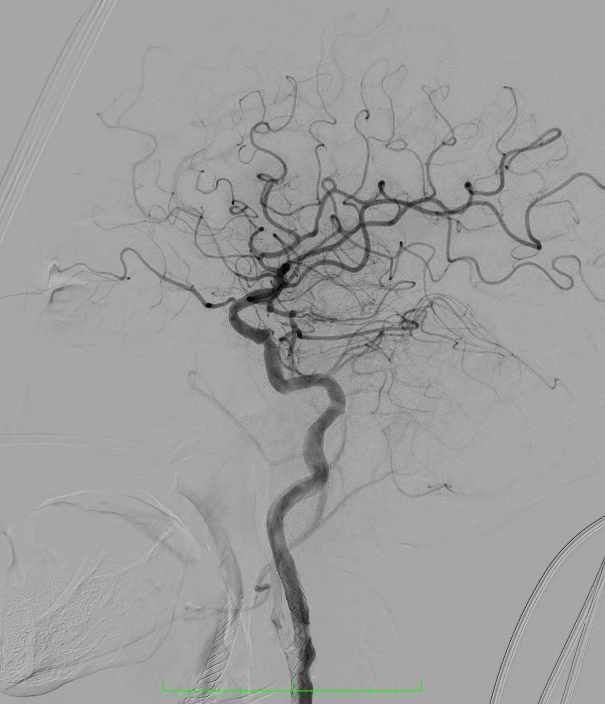
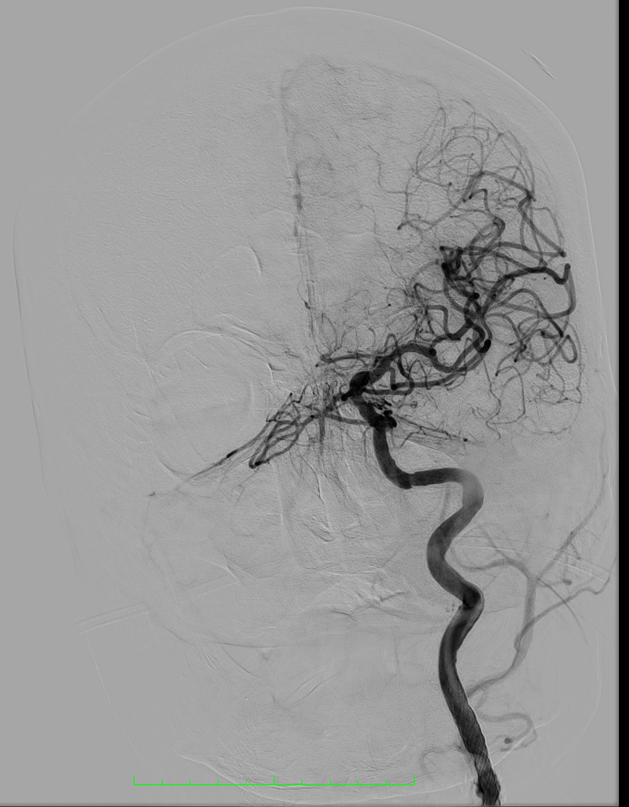
Filter retrieval (check), Final cerebral angiogram
No Symptoms, Pt discharged after one day

Slide 13
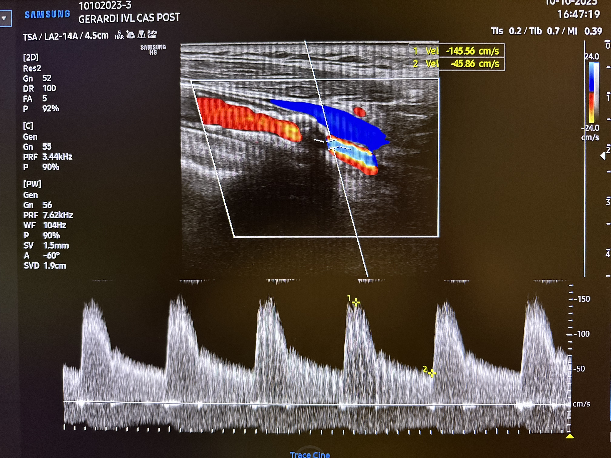
Follow-up: Post-op and 3 months DUS
Post-op DUS
3 M DUS

Slide 14
Key Takeaways
The severe calcium could not be considered a strict contraindication for CAS in every patients
By using intravascular lithotripsy it’s possible to improve carotid compliance by fracturing calcific (concentric/eccentric) plaque and allowing a safe carotid stenting without improvind embolization rates
Vessel prep by IVL could be beneficial in some selected case with contraindication for open surgery and calcified carotid plaque
Peripheral IVL has pros (more powerful/less cycles needed) and cons (60 mm length, OTW platform) compared to coronary IVL
In the next future, a new platform and sizing could be ideal to use IVL in carotid district

