Slide 1
Double mesh cas under flow reversal for ica near occlusion and collapse
CASE #

Slide 2
Patient History
77 y/o female
Simptomatic - amaurosis fugax, ICA origin near occlusion with ICA collapse;
Morbidities: Ischemic heart disease, 3 vessel CABG (2009). Old MI. Hypertension gr.III, with additional high risc. Heart failure 2-d dgr. Diabetes mellitus type II insulin nondependent.
DUS and CTA - hipoplastic ipsilateral A1, ICA origin near occlusion (2 cm calcified plaque), distal vessel collapse.
CAS decision based on comorbidities, patients choise, and the possibility of immediate neuro-thrombextraction if needed.

Slide 3
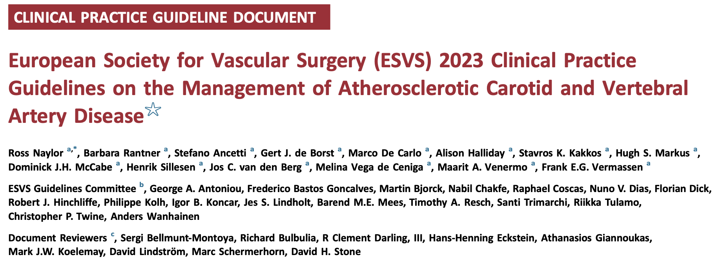
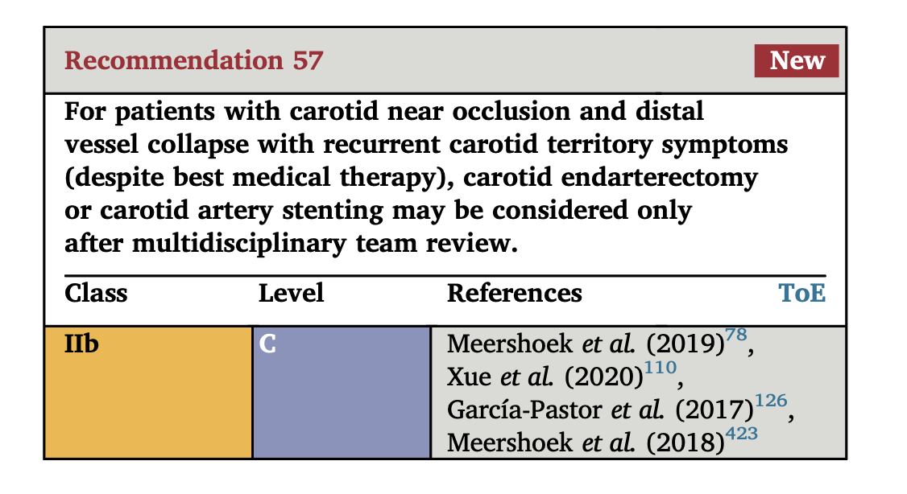

Slide 4
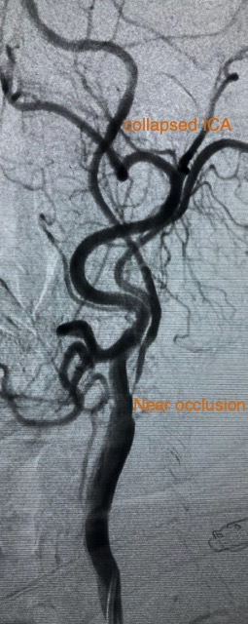
Favorable arch anatomy;
Pretreatment with DAPT for 5 days;
Initial plan to use MoMa protection device, as distal filters are not an option in this case, predilatation with a Senri 4-40 balloon and Roadsaver stent over a 0,014” Avigo wire.
The tight lesion and collapsed vessel adds complexity to the case, thus choosing the adequate cerebral protection was a priority.

Slide 5
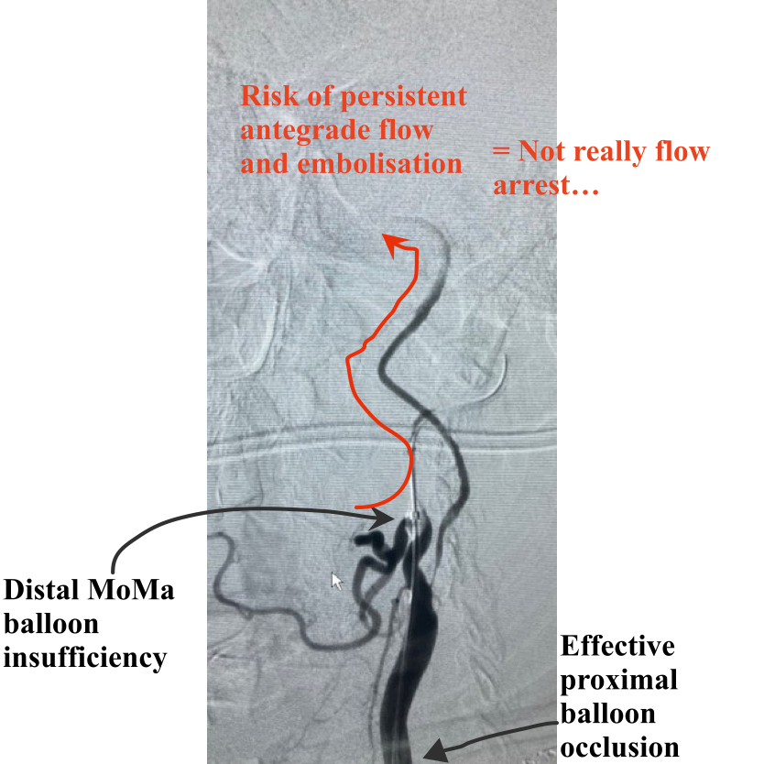
Initial cerebral protection with MoMa device
Strategy and approach

Slide 6
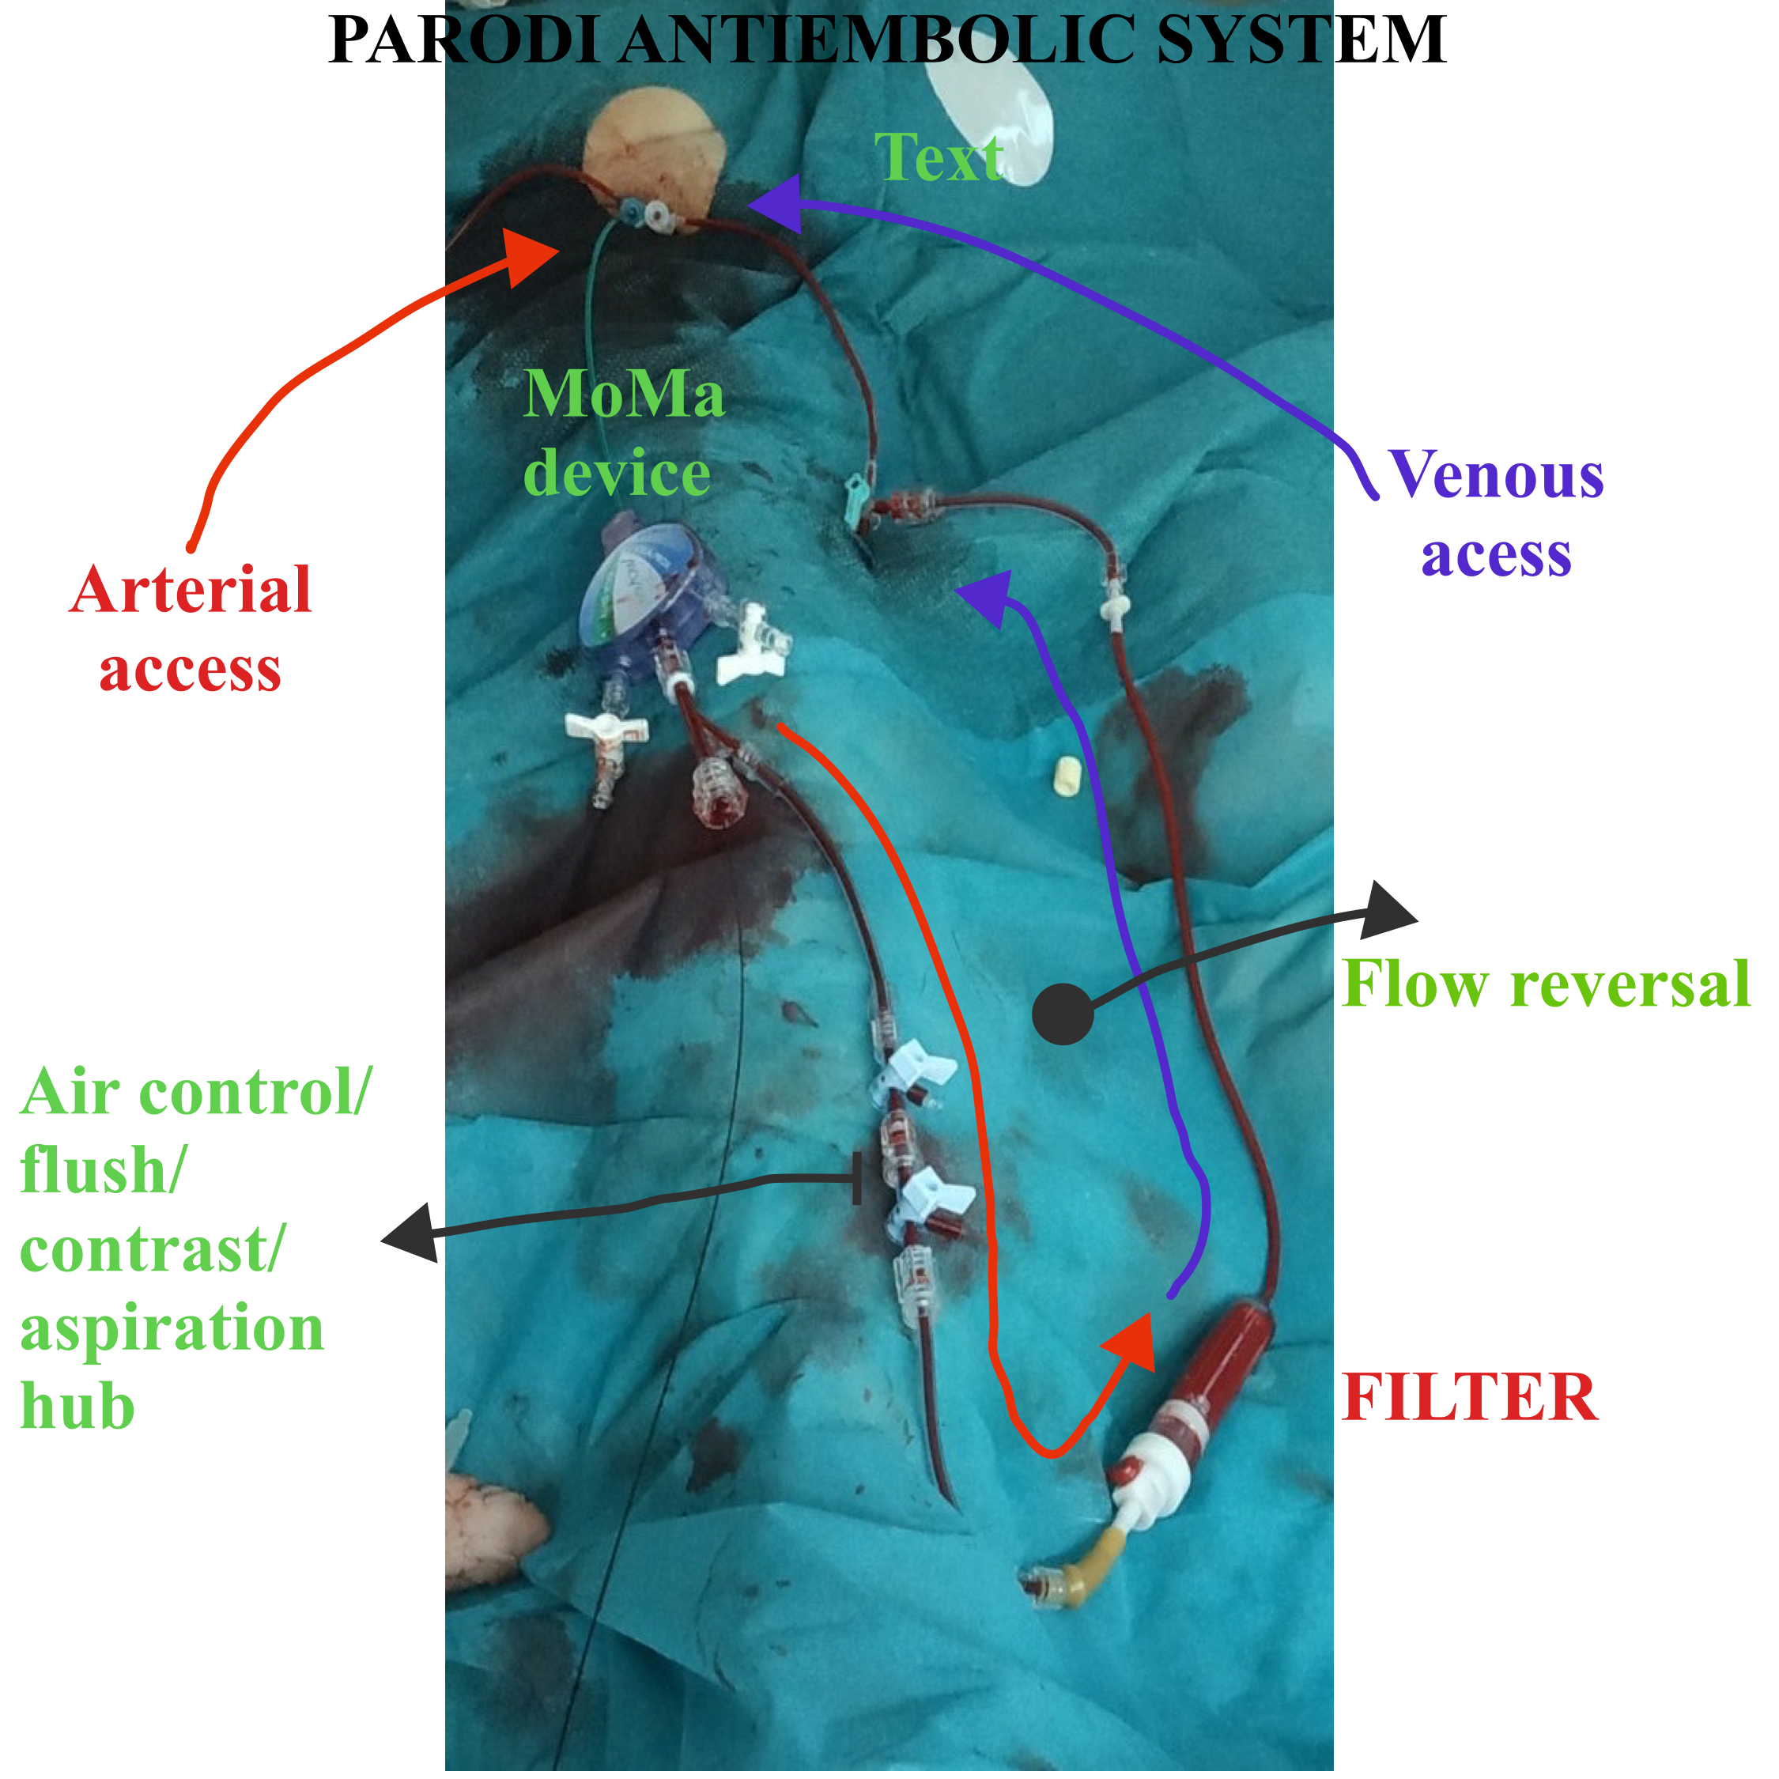
Change strategy: PARODI anti embolic system
Strategy and approach

Slide 7
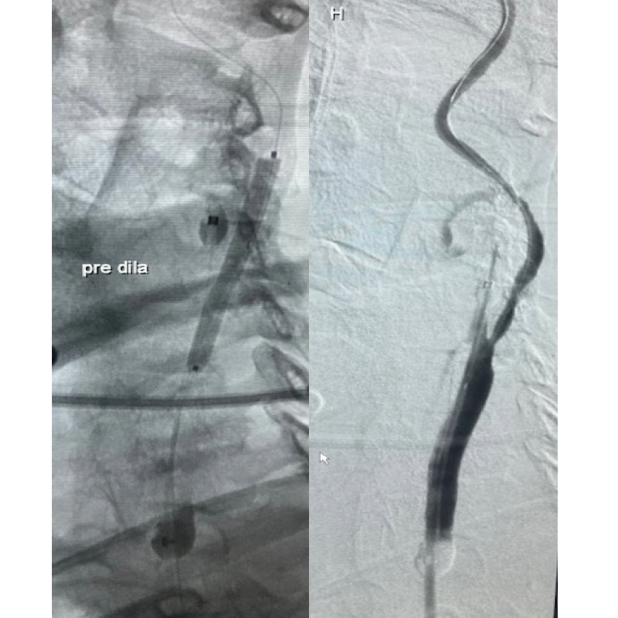
Predilatation
Senri balloon 4x40mm, over a 0.014” wire
Strategy and approach (2-3 slides)

Slide 8
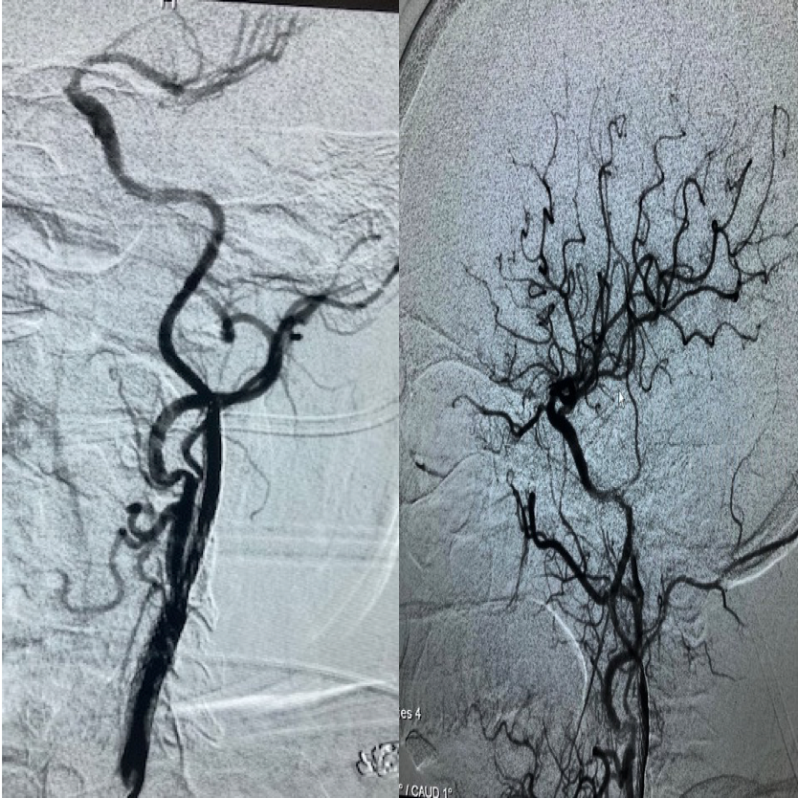
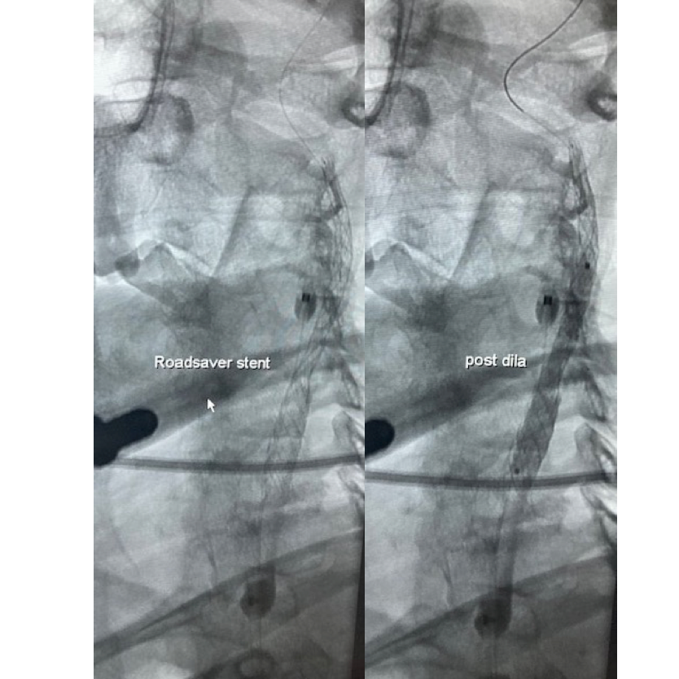
Final angio

Slide 9
Key Takeaways
Association of flow reversal to insufficient proximal protection, where distal protection is not possible may reduce the risk of embolic complications;
The near occlusion and collapse of ICA increase the complexity and time of intervention, thus demanding a secure cerebral protection from distal embolisation;
Double mesh stents (ex:Roadsaver) secure the stenotic plaque site thus decreasing the risk of embolisation in the postoperative period.

