Slide 1
Carotid bypass stenosis (radial access)
CASE #

Slide 2
Patient description
Patient History
Male, 79 yo
Previous right internal carotid artery endarterectomy (CEA) performed two times in the past; subsequent common-to-internal carotid artery bypass with great saphenous vein
Actual asymptomatic stenosis of the right common-to-internal carotid artery venous bypass
Peripheral arterial disease with occlusion of both external iliac arteries

Slide 3
Patient description
Patient History
Hepatocellular carcinoma Child-Pugh A
Hypertension, hypercholesterolemia
Number of lesions: 1
Indication to CAS due to previous CEAs and bypass
Medical therapy
Clopidogrel 75 mg chronically
ASA 100 mg started 7 days before the intervention

Slide 4
Description of the procedure
Anatomic description: occlusion of both right and left external iliac arteries, angulated origin of R-CCA from Innominate artery. Presence of a venous bypass from the middle R-CCA to R-ICA with stenosis near to distal T-T anastomosis.
BASAL CTA

Slide 5
Strategy and approach
Description of the procedure
Access from right radial artery
Engagement of R-CCA with diagnostic 5F catheter
Positioning of a supportive but not extra-stiff guidewire in R-ECA
Positioning of a 90-cm long guiding 5F sheath at the proximal part of R-CCA
Devices used
Terumo Radifocus 4F 10-cm radial introducer sheath
Cordis Tempo Cobra II 4F 65 cm diagnostic catheter
Terumo Advantage .035” 180 cm guidewire
Terumo Destination guiding sheath 5F 90 cm
BASAL ANGIO

Slide 6
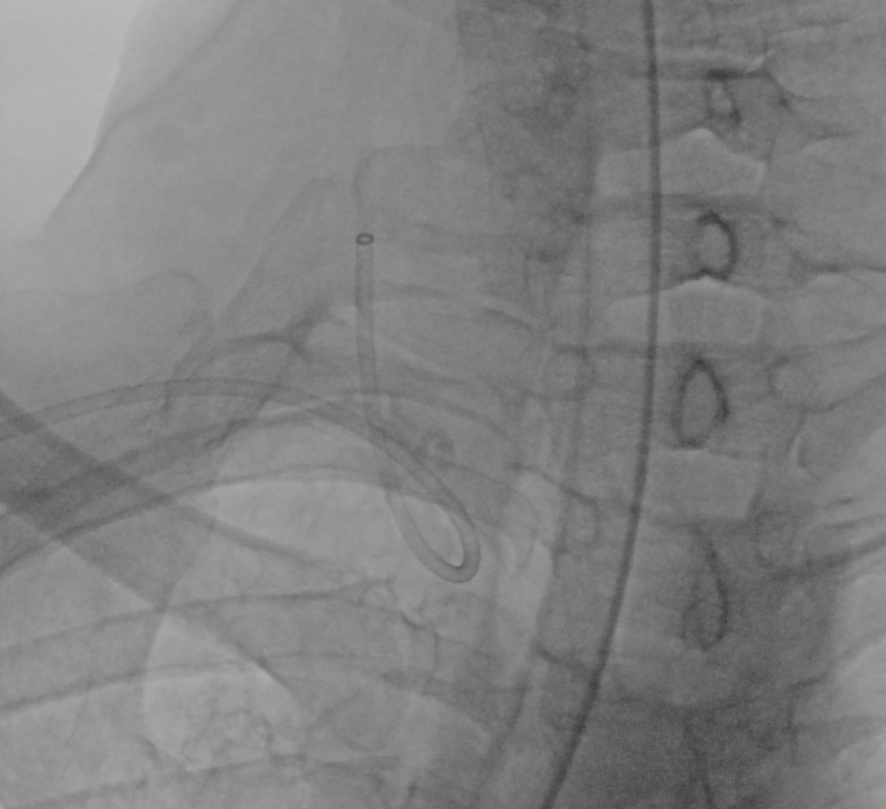
Strategy and approach
GUIDING 5F SHEATH from right radial artery

Slide 7
Strategy and approach
FILTER
Description of the procedure
Crossing of the lesion
Positioning of a dedicated filter in distal R-ICA as EPD
lesion
Devices used
Abbott Spartacore Hi-Torque 0.014” guidewire
Medtronic SpiderFx EPD 6 mm

Slide 8
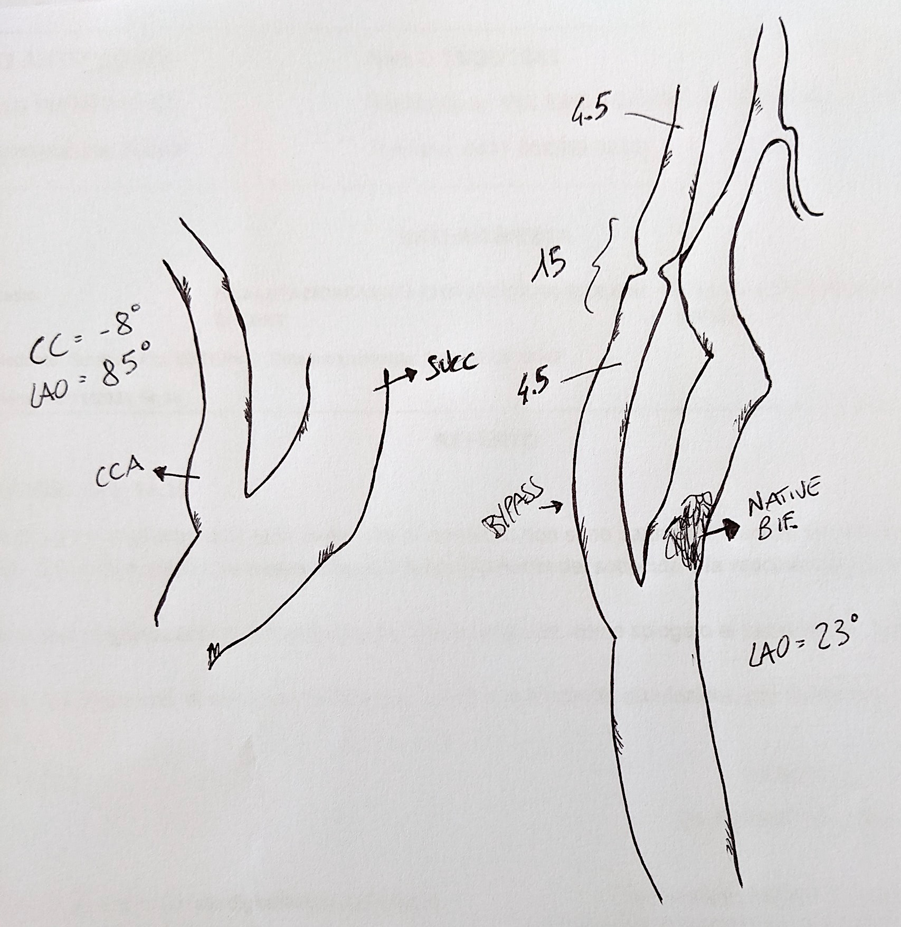
Strategy and approach
Stent implantation
Stenting area
Size of target vessel location (mm):
Proximal diameter: 4.5 mm
Distal diameter: 4.5 mm
Length: 10 mm
Stent size
Stent used: Terumo ROADSAVER 5 x 20 mm
Diameter: 5 mm
Length: 20 mm
Post dilatation
Postdilatation of the stent with Sterling balloon 5 x 20 mm

Slide 9
Strategy and approach
Stent implantation
STENT DEPLOYMENT
POST DILATATION
AFTER BALLOONING

Slide 10
Final angio

Slide 11
Key Takeaways
Regular follow-up is mandatory after CEA / CAS, and some patients could present recurrent re-stenosis
Long, armed, 5F Destination guiding sheath permits to approach to CCA also in tortuous anatomies
Roadsaver carotid stent showed impressive navigability in this case
Radial access is an useful alternative to brachial artery, with
hemostasis easily obtain using TR band
Hemostasis at the end of the procedure

